Slide 1

PBCST504 – MICROCONTROLLERS
MICRO PROJECT
Zeroth Review

Slide 2
Title:-Fake Wi-Fi Access Point Detection System using ESP32
Group No:10
Members:
Adhith Kumar A S -JEC24CC005
Annliya P J -JEC24CC022
Buvana Krishna V B -JEC24CC027
Ciril J Chiramel-JEC24CC028
Gautham Krishna C A – JEC24CC034
Project Coordinator:
Ms.Sagna L T
Asst. Prof. CSE(CY)

Slide 3
DEPARTMENT OF COMPUTER SCIENCE & ENGINEERING
(Cyber Security)
Vision of the Department
To be a globally recognized centre of excellence in Cyber Security education, research and innovation by nurturing ethical professionals , fostering technological advancement through responsible practice and contributing to a secure and sustainable digital society.

Slide 4
DEPARTMENT OF COMPUTER SCIENCE & ENGINEERING
(Cyber Security)
Mission of the Department
M1: Excellence in Education : To provide outcome-based and industry-oriented education by integrating core computer science principles with advanced cybersecurity technologies and practices.
M2: Ethics and Professional Responsibility : To cultivate ethical values, integrity, social responsibility, and secure computing practices for protecting digital assets and strengthening cyber trust.
M3: Research, Innovation, and Entrepreneurship : To promote research, innovation, and entrepreneurial thinking for developing sustainable solutions to emerging cybersecurity challenges.
M4: Holistic and Global Development : To enhance leadership, teamwork, lifelong learning, and global competence through industry collaboration, interdisciplinary activities, and community engagement.

Slide 5
Programme Educational Objectives (PEOs)
PEO 1: Graduates will apply strong foundations in computer science and cybersecurity to design, develop, and manage secure and reliable computing systems for industry and society.
PEO 2: Graduates will pursue successful careers as professionals, innovators or entrepreneurs engaged in technology development, deployment or engineering system implementation in industry and society and contribute to the economic growth of the country.
PEO 3: Graduates will demonstrate ethical responsibility, leadership, teamwork, and effective communication while adapting to evolving global technological environments through lifelong learning.

Slide 6
Programme Outcomes
Engineering Graduates will be able to:
1. Engineering knowledge: Apply the knowledge of mathematics, science, engineering fundamentals, and an engineering specialization to the solution of complex engineering problems.
2. Problem analysis: Identify, formulate, review research literature, and analyze complex engineering problems reaching substantiated conclusions using first principles of mathematics, natural sciences, and engineering sciences.
3. Design/development of solutions: Design solutions for complex engineering problems and design system components or processes that meet the specified needs with appropriate consideration for the public health and safety, and the cultural, societal, and environmental considerations.
4. Conduct investigations of complex problems: Use research-based knowledge and research methods including design of experiments, analysis and interpretation of data, and synthesis of the information to provide valid conclusions.
5. Modern tool usage: Create, select, and apply appropriate techniques, resources, and modern engineering and IT tools including prediction and modeling to complex engineering activities with an understanding of the limitations.

Slide 7
6. The engineer and society: Apply reasoning informed by the contextual knowledge to assess societal, health, safety, legal and cultural issues and the consequent responsibilities relevant to the professional engineering practice.
7. Environment and sustainability: Understand the impact of the professional engineering solutions in societal and environmental contexts, and demonstrate the knowledge of, and need for sustainable development.
8. Ethics: Apply ethical principles and commit to professional ethics and responsibilities and norms of the engineering practice.
9. Individual and team work: Function effectively as an individual, and as a member or leader in diverse teams, and in multidisciplinary settings.
10. Communication: Communicate effectively on complex engineering activities with the engineering community and with society at large, such as, being able to comprehend and write effective reports and design documentation, make effective presentations, and give and receive clear instructions.
11. Project management and finance: Demonstrate knowledge and understanding of the engineering and management principles and apply these to one’s own work, as a member and leader in a team, to manage projects and in multidisciplinary environments. 12. Life-long learning: Recognize the need for, and have the preparation and ability to engage in independent and life-long learning in the broadest context of technological change.

Slide 8
Programme Specific Outcomes (PSOs)
On the completion of Computer Science & Engineering program, the students will possess:
PSO 1: Apply cyber security principles to mitigate cyber risk and analyze security requirements of an organization.
PSO 2: Develop and deploy secure software and infrastructure using modern tools and industry standards.
PSO 3: Uphold ethical, legal, and societal responsibilities while protecting privacy, data, and digital assets.

Slide 9
CONTENTS
Motivation
Introduction
Problem Statement
Proposed Method
Basic Block Diagram
Conclusion
References

Slide 10
Motivation
Public Wi-Fi networks are widely used.
Attackers create fake Wi-Fi hotspots (Evil Twin).
Users may unknowingly connect and lose sensitive information.
Need for a low-cost, portable detection system.

Slide 11
Introduction
ESP32 scans nearby Wi-Fi networks. Detects suspicious access points using SSID, BSSID, security type, and signal strength. Compares the detected network with a trusted Wi-Fi database to identify possible fake (Evil Twin) access points. Alerts users through LED, buzzer, OLED display, and a web dashboard.

Slide 12
Problem Statement
Fake Wi-Fi hotspots are difficult for users to identify. Existing detection methods are expensive or require technical expertise. Users are at risk of data theft and credential theft. There is a need for an affordable, real-time Wi-Fi monitoring and detection system..

Slide 13
Proposed Method
ESP32 scans nearby Wi-Fi networks.
Compare detected networks with trusted network information.
Detect:
Different BSSID for the same SSID.
Security downgrade.
Duplicate SSIDs.
Sudden RSSI changes.
Generate alerts via LED, buzzer, OLED, and dashboard.

Slide 14
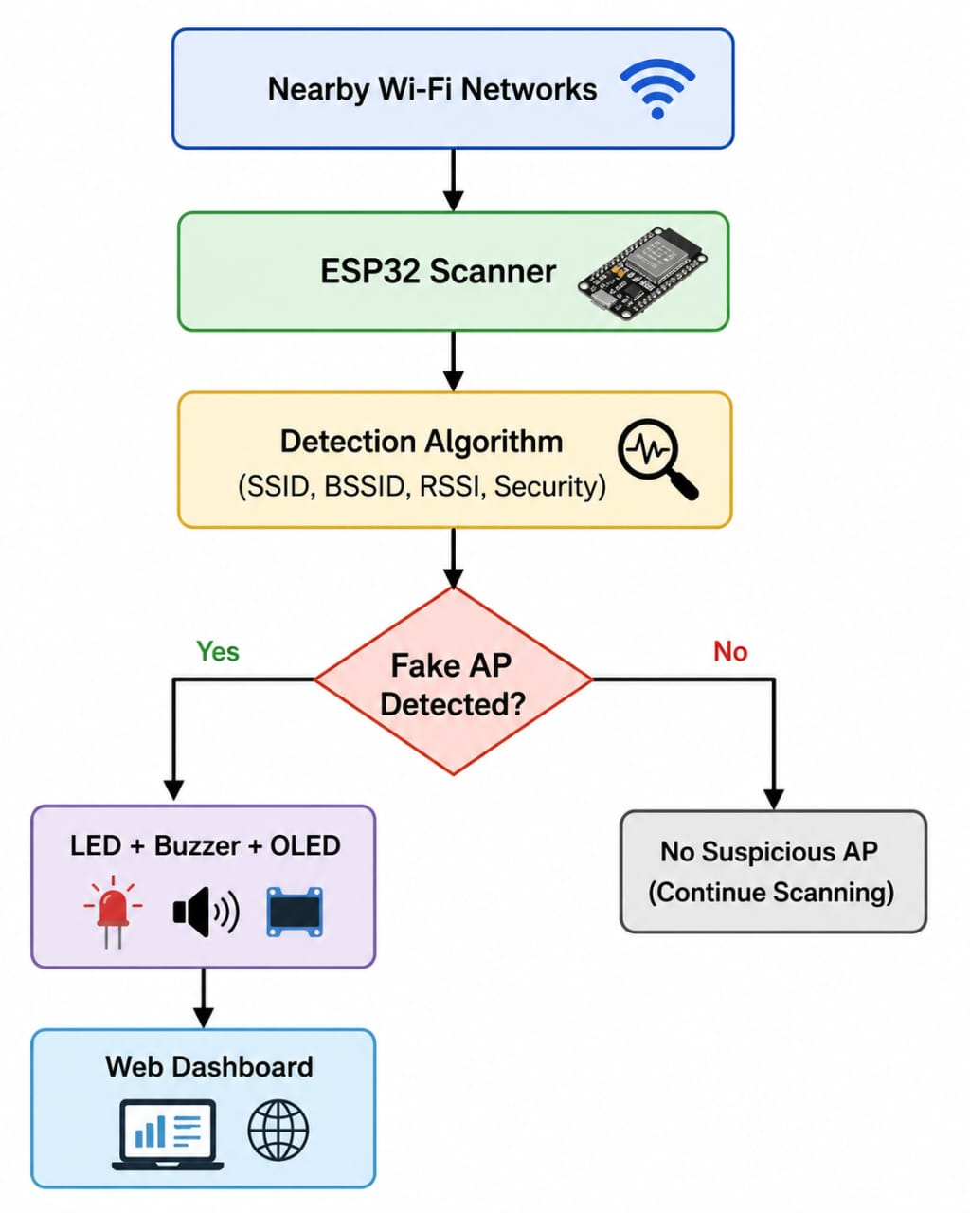
Basic Block Diagram

Slide 15
Conclusion
Detects fake Wi-Fi access points in real time.
Low-cost and portable solution.
Improves user awareness and network security.
Can be enhanced with Telegram alerts and cloud logging.

Slide 16
References
ESP32 Arduino Documentation
IEEE Papers on Evil Twin Attacks
Espressif ESP32 Documentation
Arduino IDE Documentation

